Slide 1
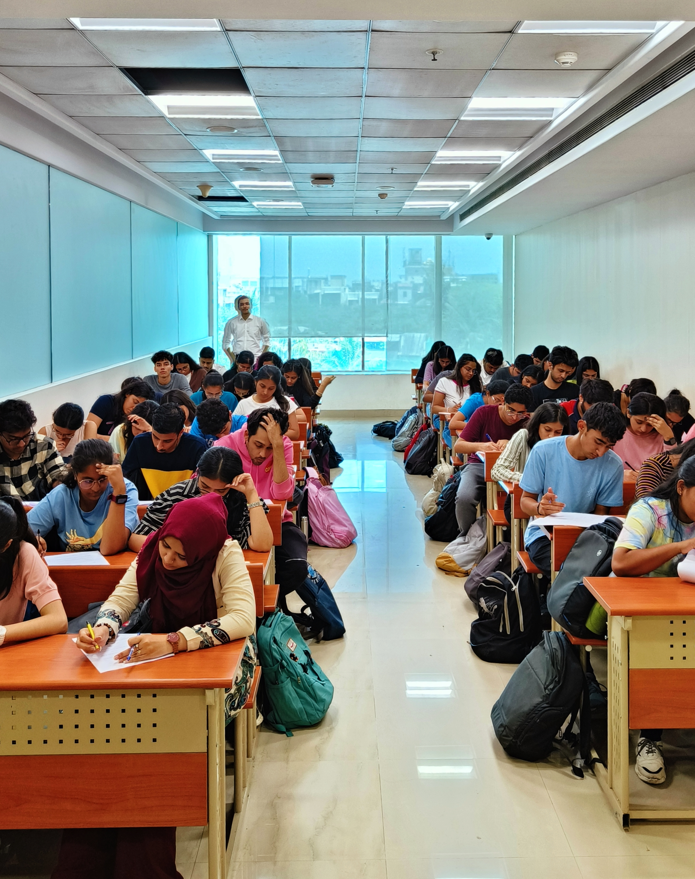
ANAMOLY DETECTION: EXAM RESPONSES
GROUP MEMBERS : Hrushikesh Chavan A011
Snehal Shirvaiker A013
Shreyas Kulkarni A014
Rashil Shah A015
Shruti Jagdale A026
Mentor : Prashant Dhamale

Slide 2

CONTENTS
04
CONCLUSION
02
OFFLINE EXAMINATION
05
LIMITATIONS & FUTURE SCOPE
03
ONLINE EXAMINATION
01
OBJECTIVES

Slide 3

OBJECTIVES
To find out similarity between responses for MCQs given by students in offline mode using clustering methods.
To find out similarity between documents submitted by students in online mode using clustering and cosine similarity.

Slide 4

OFFLINE EXAMINATION ANALYSIS
DATA DESCRIPTION
THEORY
DATA ANALYSIS
OUTPUT
Notes:
\

Slide 5
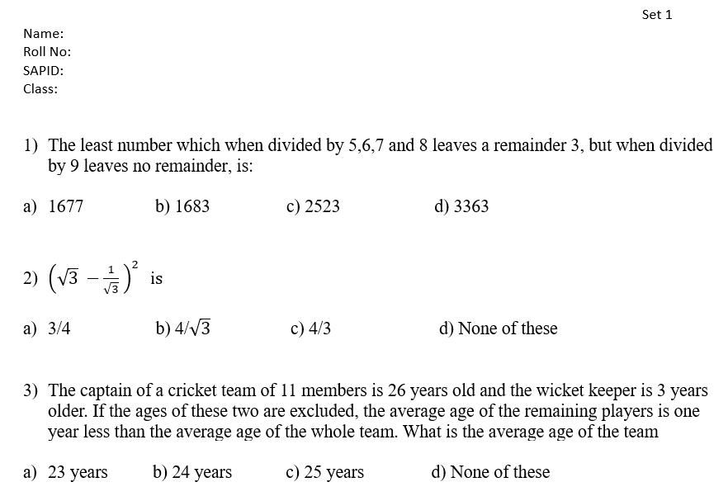
DATA DESCRIPTION
DATA:
20 Quant Questions were taken from IndiaBix
Prepared 3 sets
Question’s Difficulty level:
6 Easy
8 Medium
6 Hard
Sample size: 51

Slide 6
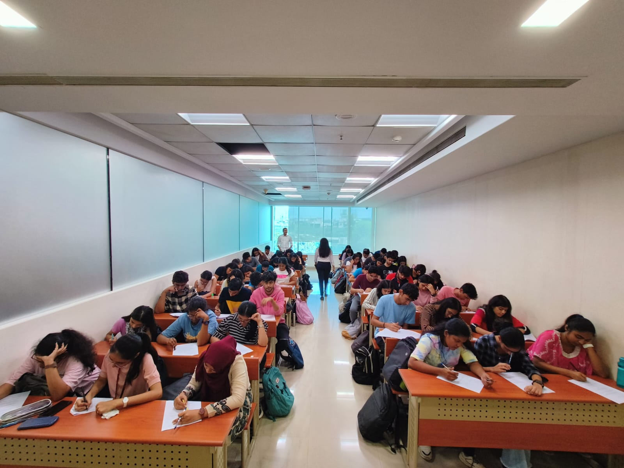
SEATING ARRANGEMENT
T18
T9
T8
T10
T7
T11
T6
T12
T5
T13
T4
T14
T3
T15
T2
T16
T1
T17
S1 S2 S3

Slide 7
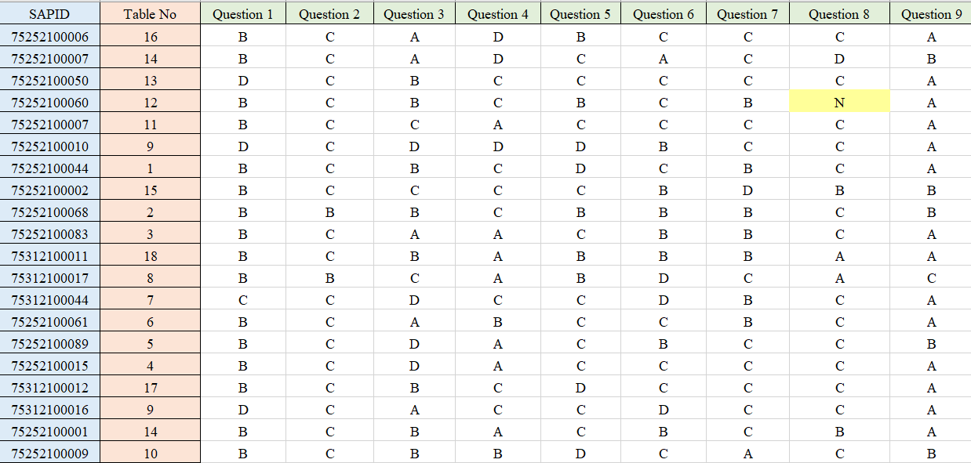

Slide 8
GOWER DISTANCE
Gower distance is a measure of the closeness between 2 records.
These records can be combination of logical, numerical, categorical or text data.
In the case of categorical variables, Gower distance is calculated as follows:
Example:
1 | A | C
2 | A | D
Distance = ½ =0.5

Slide 9
DISSIMILARITY MATRIX THEORY
A dissimilarity matrix is a square matrix that represents the dissimilarity or distance between pairs of objects in a dataset.
Each element of the matrix represents the distance between two objects, which can be computed using various distance metrics.

Slide 10
HIERARCHICAL CLUSTERING
Method for grouping objects
It creates groups so that objects within a group are similar to each other and different from objects in other groups
Visual represented in a hierarchical tree called a dendrogram.
Advantage: 1) no need to pre-specify the number of clusters
2) Data is easily summarized/organized into a hierarchy using dendrograms.
Agglomerative
each object is considered to be its own cluster
the clusters are then merged step by step until a single cluster remains
Divisive
all objects are considered in a single cluster
division process is performed step by step until each object forms a different cluster

Slide 11
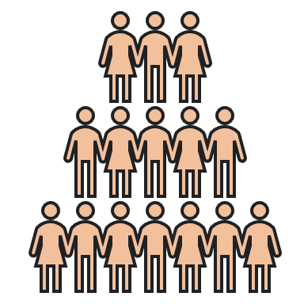



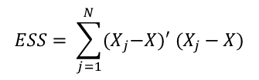
WARD’s METHOD
Starts with n clusters
Each has a single object
Every possible combination of
clusters considered
$$ESS= \sum_{j=1}^{N}{{(X}_{j}−X})′ (X_{j}−X)$$
All n clusters are combined
One cluster has all objects

Slide 12
DATA ANALYSIS
DISSIMILARITY MATRIX AND CLUSTERING ON:
FULL DATA
EASY QUESTIONS
MEDUIM QUESTIONS
HARD QUESTIONS

Slide 13
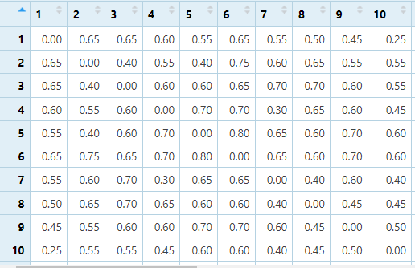
ON DATA WITH ALL TYPE OF QUESTIONS
Converted into a distance matrix
Used in clustering

Slide 14
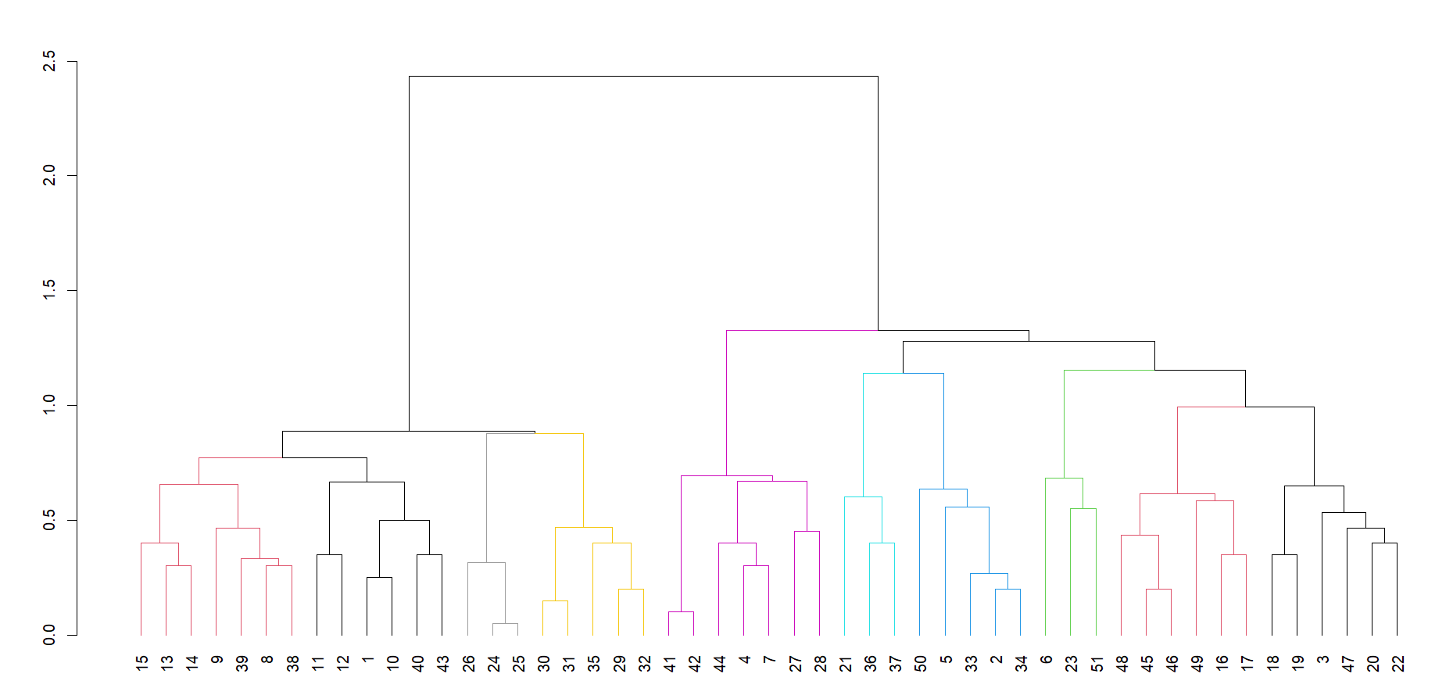

Slide 15
OUTPUT FOR OVERALL DATA
S45
S46
S16
S17
S24
S25
S26
S41
S42
S11
S12
S13
S14
S15
S31
S32
S35

Slide 16
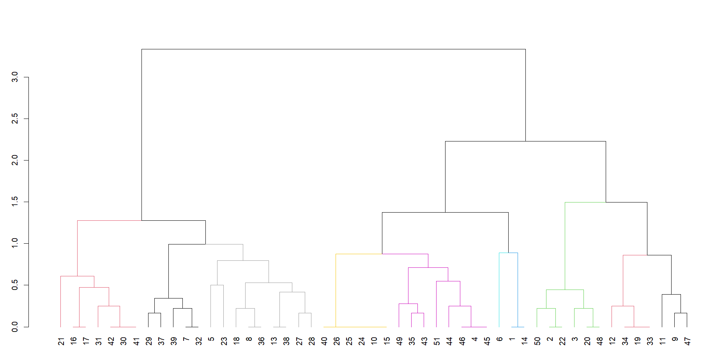
On Easy questions

Slide 17
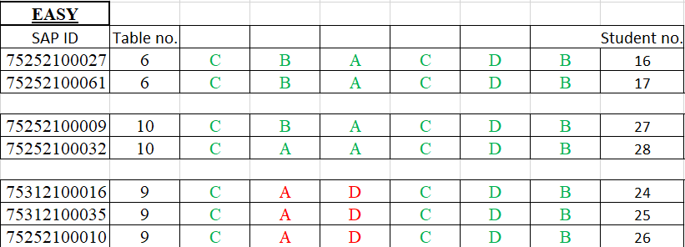
OUTPUT FOR EASY QUESTIONS

Slide 18
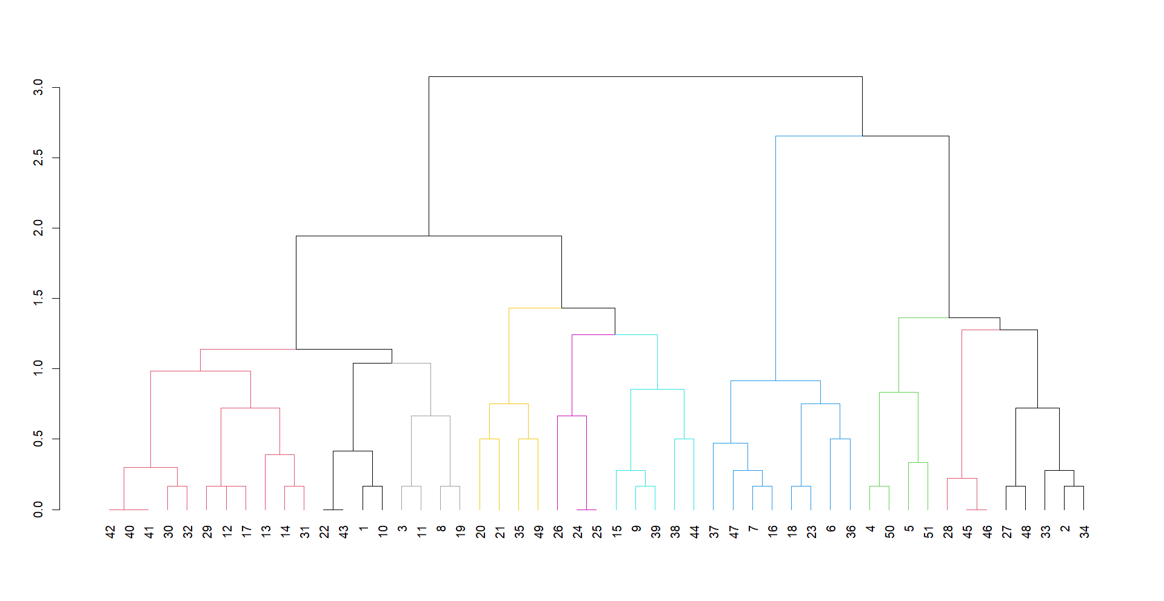
On Medium questions

Slide 19
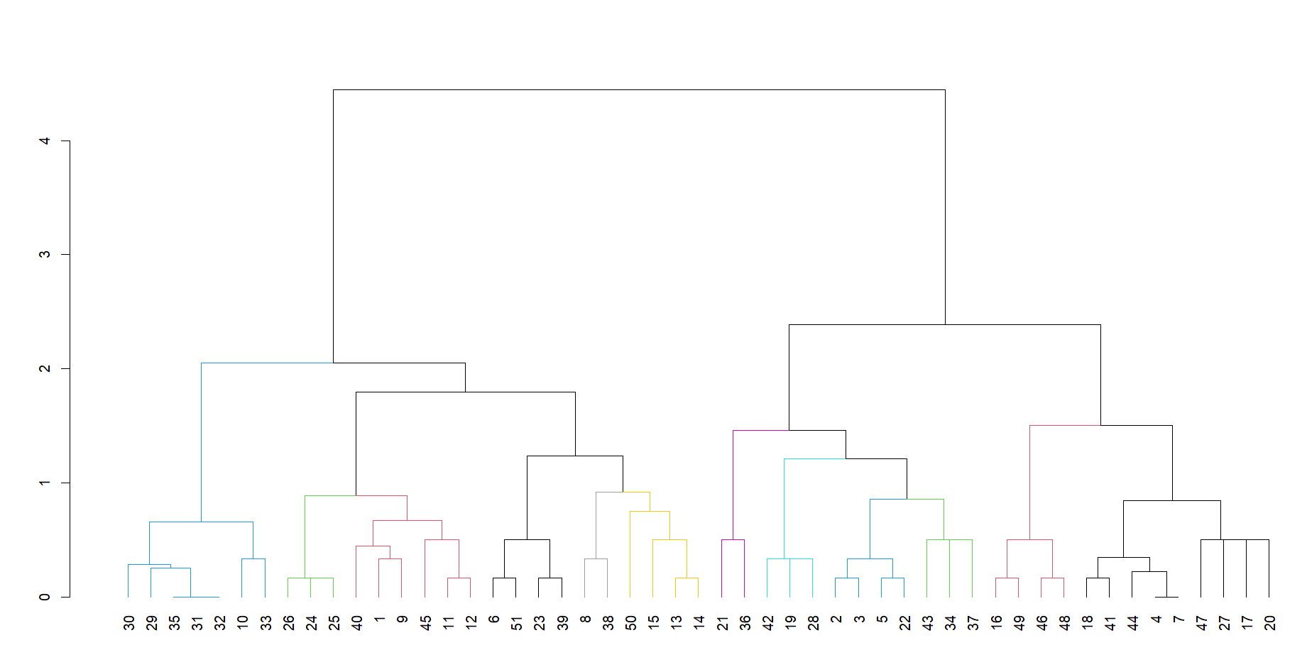
On Hard Questions

Slide 20
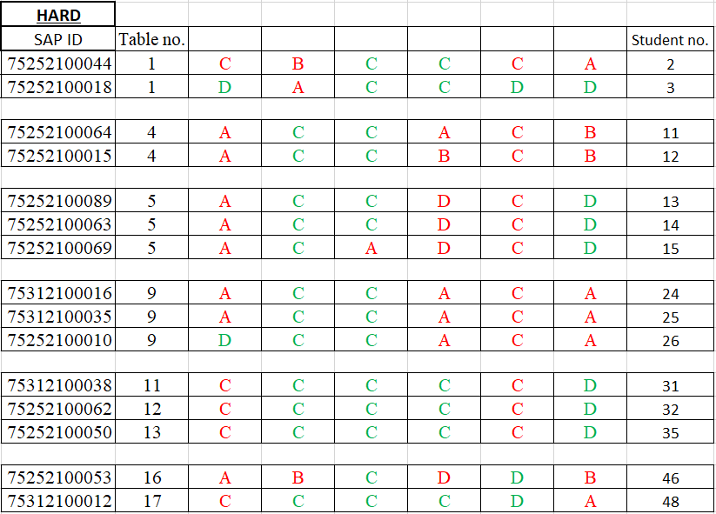
OUTPUT FOR HARD QUESTIONS

Slide 21
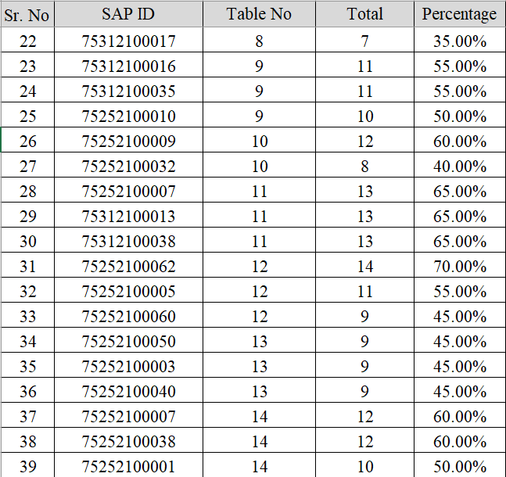
RESULTS:
T18
T9 24 25
T8
T10 26
T7
T11
T6
31 32 T12
T5
13 14 15
35 T13
T4
11 12
T14
T3
T15
T2
T16
T1
T17
S1 S2 S3

Slide 22

ONLINE EXAMINATION ANALYSIS
DATA PRE-PROCESSING
WARD’S HIERARCHICAL CLUSTERING
COSINE SIMILARITY

Slide 23
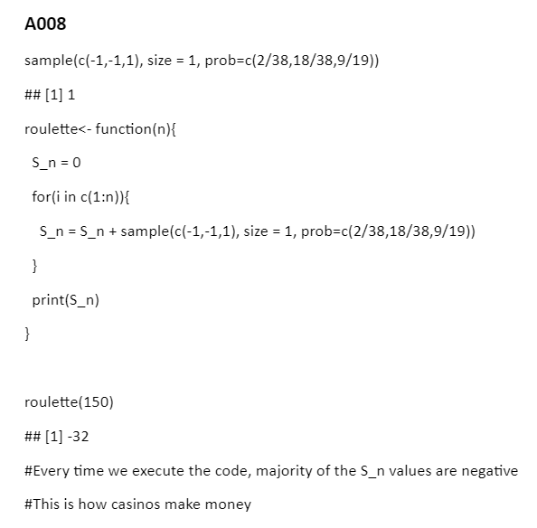


DATA DESCRIPTION
DATA
SIZE
Assignment
Logic Building Q.7)
40 students

Slide 24
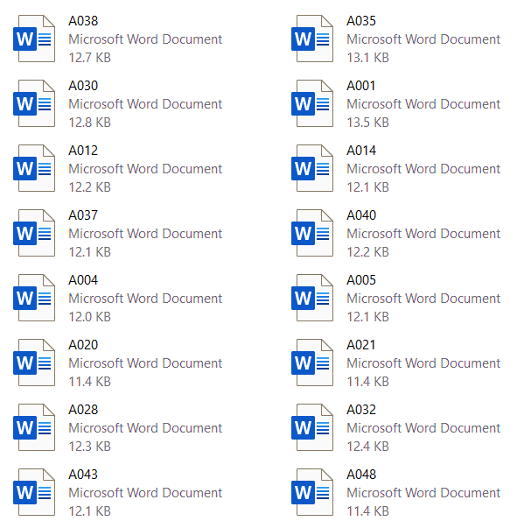


DATA PRE-PROCESSING
EXTRACTION
Extract text from Word document
TF - IDF
Vectorize the text
TF-IDF scores

Slide 25
EXAMPLE FOR TF - IDF
Vector
v1=[“apple”, ”apple”, ”banana”]
v2=[“apple”, ”guava”,” grapes”]
v3=[“mango”,” kiwi”,” chiku”]
IDF
tf = 1
df = 1
idf = log(N/(df+1))
idf = 0.1760
TF - IDF
tfidf = tf * idf
Tfidf=0.1760

Slide 26
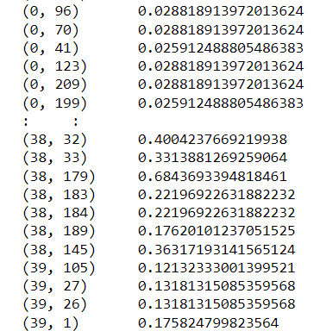
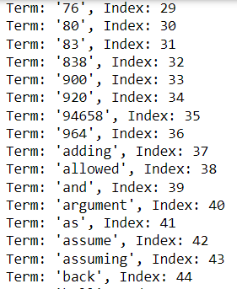
TF-IDF RESULTS
TF-IDF score
VOCABULARY

Slide 27
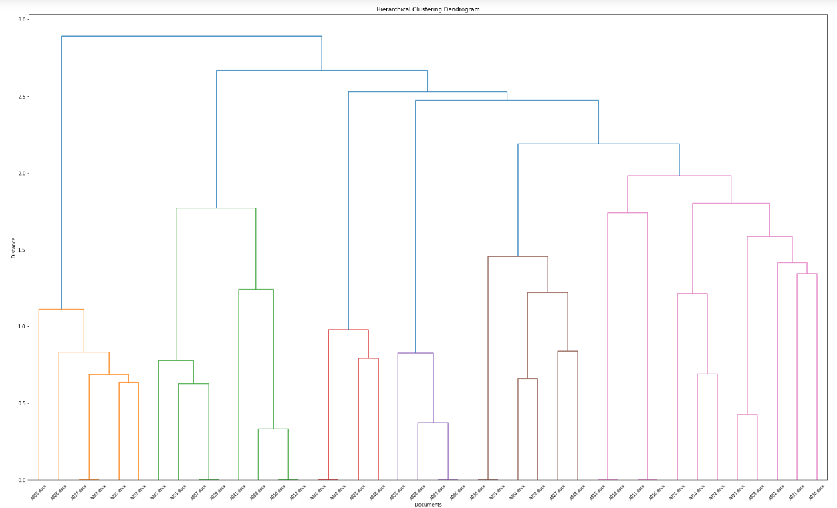

Slide 28
OUTPUT:
A010
ESS=0
A037
A043
A008
A007
A049
A007
A029
A030
A031
A012
A051
A046
A048
A006
A003
A016
A011
A020

Slide 29
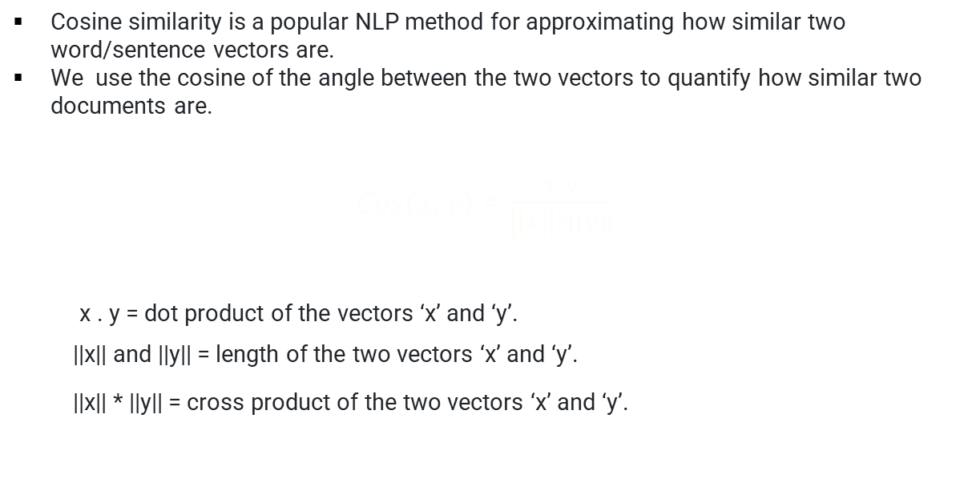
THE COSINE SIMILARITY
Cosine similarity is a popular NLP method for approximating how similar two word/sentence vectors are.
We use the cosine of the angle between the two vectors to quantify how similar two documents are.
$Cos(x,y)$ = $\frac{x.y}{\left|\left|x\right|\right|∗|\left|y\right||}$
Cos(x, y) = x . y / ||x|| * ||y x . y = dot product of the vectors ‘x’ and ‘y’.
||x|| and ||y|| = length of the two vectors ‘x’ and ‘y’.
||x|| * ||y|| = cross product of the two vectors ‘x’ and ‘y’.

Slide 30
Results : Cosine Similarity
100%
A003-A006
A010-A012
A007-A029
A011-A016
A015-A018
A030-A031
A046-A048
A037-A043
95.79%
94.87%
A008-A010
A008-A012
90.95%
85.29%
A003-A020
A020-A006
A023-A039
A007-A051

Slide 31
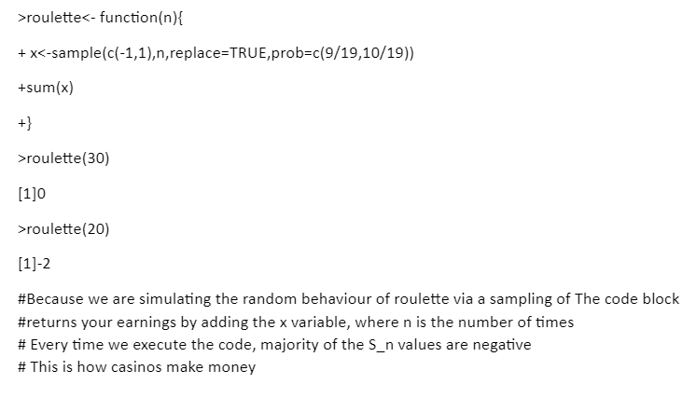
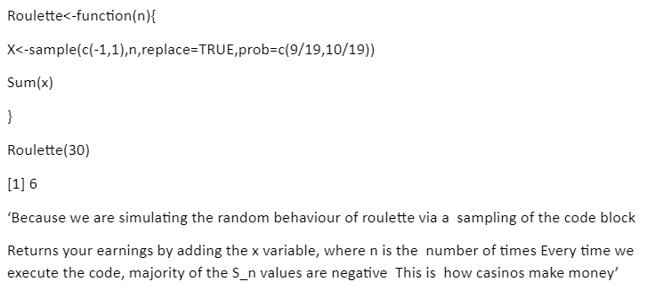
Ex.- Student ID’s with Similarity 90.95
A039
A023

Slide 32
CONCLUSION
According to the threshold set, we can say that there is high probability of cheating among the Roll nos. mentioned above.
Based on the professors with his students, he can conclude our results as being coincidental or a copy case.

Slide 33
LIMITATIONS
Data with 3 students on each table.
Individual cheating can’t be detected.
E.g.Chits
In online exam analysis: if 2 students have referred to the same site, similarity is detected

Slide 34
UPCOMING UPDATES
Analysis can be done with less than 3 students on one bench.
OCR technique to extract the text from the handwritten documents submitted by students and analysis like online mode can be done.
Will advice institutions to reduce manpower by just checking the cctv footage
ML technique can be used for checking the footage, giving threshold value for the variance and check the movement of the students.

Slide 35
REFERENCES

Slide 36
THANK YOU!

